Slide 1
Problem Solving and Critical Thinking Assignment
Submitted by:
Nishant Shah
19225760035

Slide 2
Next article will be popular or not
Mashable Inc.- The goal of this study is to predict to predict the popularity of a given article

Slide 3

Different Articles !!

Slide 4
Objective:
To look for any meaningful insights in the article data available.
To Understand what factors contributed most in predicting whether an
article will be popular or not.
To create or improve any strategies to engage viewers and readers
for reading our articles and to share them as well.
To create a model that predicts the popularity of an online article
before it is published

Slide 5
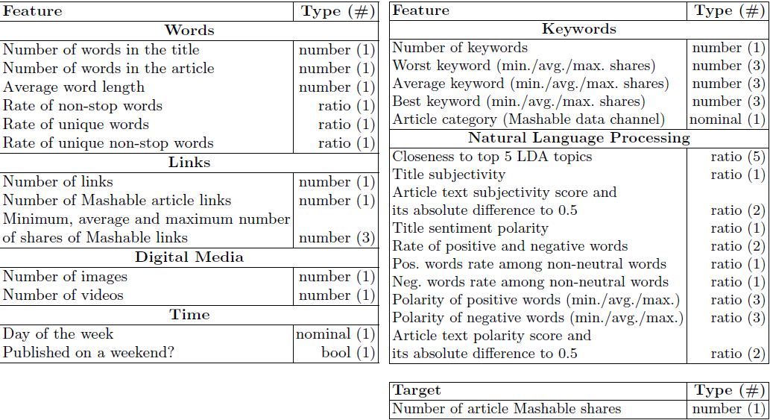
Data Dictionary is as below

Slide 6
Let’s talk about The Problem
Online platforms like Medium, Buzfeed, Mashable etc. publish hundreds of articles ever day.
These articles belong to certain categories like entertainment, sports, technology, world etc.
So it is really important for an Online platform to get the maximum readers. And if they don’t get desired amount of readers then it is a serious business problem for them.
Even the business may likely experience falls if they fail to get good amount of readers and sharers.

Slide 7
Critical Thinking Approach
Here are a few ways in which we may increase the shares and readers of an article:
Search Engine Optimization (SEO)
Pay Per Click (PPC) Advertisement
Social Media
In-Person Networking
Blogging
Referrals
Moreover, we can also break up Long Posts by using the Page-Link Tag. Also by insert relevant and related links in the right places. Then one other option is by interlinking the various internal articles.
Also by including more graphics, animated images and relevant video contents can help increasing the popularity of article.

Slide 8
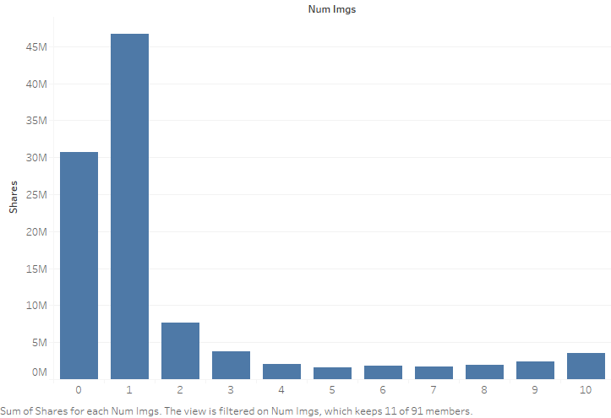
Bar Graph: Image v/s Shares
It would be wise to include either 0 or 1 image in an article.

Slide 9
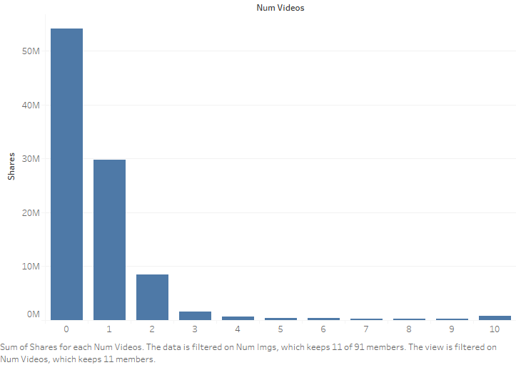
Articles that have no videos tend to do best.
The articles that have more than 2 videos are negligible in comparison.

Slide 10
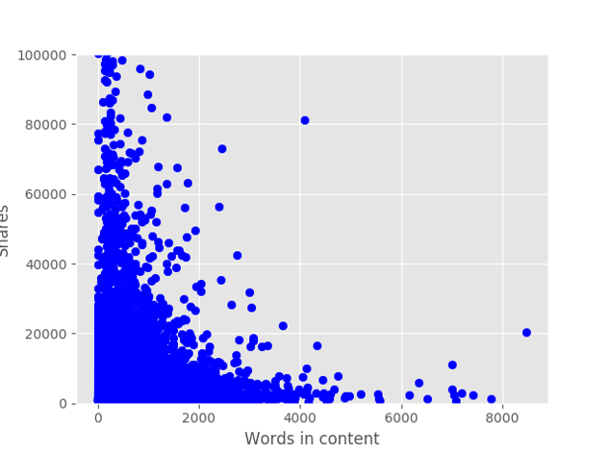
Scatter Plot: Words in content v/s Shares
People do not like to read longer news articles and hence would not share
longer articles.

Slide 11
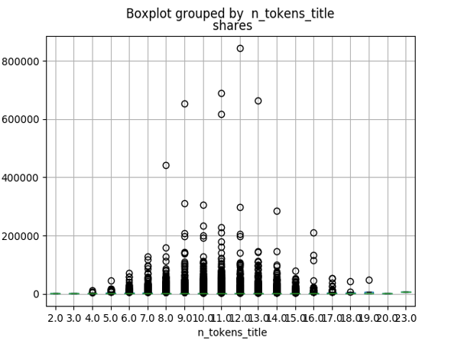
Variance in the data:
The number of tokens in the title may determine whether the reader would
like to read more or not.

Slide 12
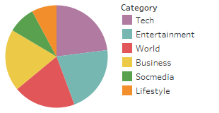
Pie Chart:
The best performing category is Tech, followed by Entertainment, World, and
Business. The least popular categories are Social Media and Lifestyle.

Slide 13
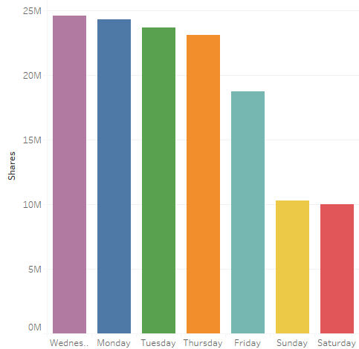
Bar Chart:
As you can see, the weekdays have the highest number of shares. Wednesday,
Monday, Tuesday, and Thursday have the highest number of shares,
with Friday having a significant drop.

Slide 14
Inference of insights from the ML model
and EDA Strategies
Increase the:
Number of embedded links
Number of images
Articles on Technology category
Amount of subjectivity in title.
Number of words which are more popular.
References to older articles which have high popularity

Slide 15
Decrease the:
number of longer words in the content
amount of multi-topic discussion in an article (Articles which talk about multiple topics perform poorly)

Slide 16
Thank You

